Slide 1
Video Stabilization Using Point Feature Matching and MATLAB
GUIDE:
Mrs. K. KAVYA
Assistant Professor, ECE Department
PRESENTED BY:
S. Yashaswi Ranga 2451-16-735-126
P.Suman 2451-16-735-138
R. Amartya Varma 2451-16-735-140

Slide 2
CONTENTS
Abstract
Introduction
Flow Chart
Algorithm
Result
Applications
Conclusion And Future Scope
References

Slide 3
ABSTARCT
Video capturing by non-professionals will lead to unanticipated effects. Such as image distortion, image blurring etc. Hence, many researchers study such drawbacks to enhance the quality of videos.
In this paper an algorithm is proposed to stabilize jittery videos. A stable output video will be attained without the effect of jitter which is caused due to shaking of handheld camera during video recording. Firstly, salient points from each frame from the input video is identified and processed followed by optimizing and stabilize the video.

Slide 4
INTRODUCION
What is video stabilization?
Video stabilization refers to algorithms used to improve video quality by removing unwanted camera shakes and jitters due to hand jiggling and unintentional camera panning. Generally the processes of stabilization goes through three phases namely.
Motion estimation
Motion smoothing
Motion compensation.

Slide 5
FLOW CHART
Read Frames from Video File
Collection of Salient Points from each Frame
Calculation Of MSE’s between Compensated Images and Current Frame
Compensation of the images to row, column and Static frame
Transform Approximation & Smoothing
Arrange all the Transformed images
Final Output Of Corrected Frame Sequence
Fig1 : Flow Chart

Slide 6
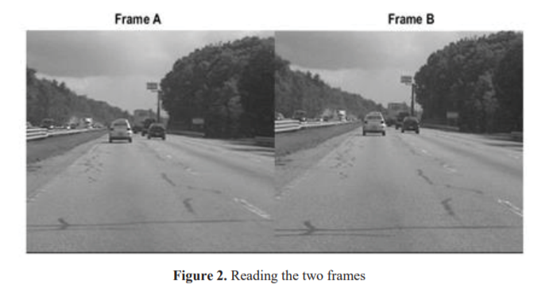
ALGORITHM
Step1 : Selecting Videos and Dividing into Frames
-Browse Video from the files given in this step, Calculate the number of frames in the video. And the value of number of Frames is stored and the Video is tagged to “Myreader1”. [RGB colours are not preferable] Fig.2 shows two frames side by side out of all the frames. The data related intensity of images has been Stored and used in the next step.

Slide 7
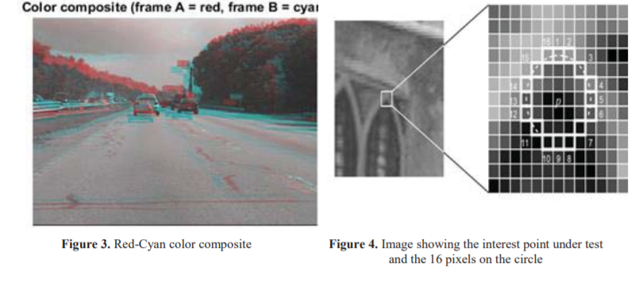
Step2 : Collection of Salient Points from Each Frame and Conversion to Gray Scale.
-After reading all the frames, Each frame is Converted from RGB to Gray scale pixel wise and the figure is shown below (Fig3). To generate these correspondences, collection of points of interest from all the frames is performed. Once the Information i.e. the pixel values of every frame is noted then they are used in the following stages .
Fig 3 : Shows the pixel values of a single frame in Gray Scale

Slide 8
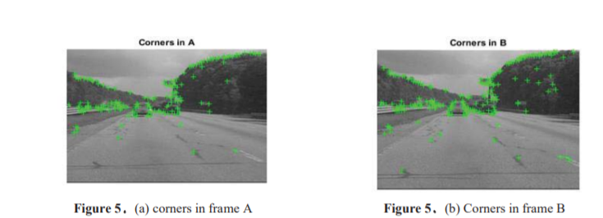
Step3: Compensating Row, Column and Static Frame :
- The Row Compensated image is shifted by a factor of 21 to the left, The column compensated image is Shifted by a factor of 21 to the top , and the Static frame is a copy of the original image not to alter its original data.
Fig4 (A) : Frame A
Fig4 (B) : Frame B

Slide 9
Step4 : Calculation Of MSE’s between Compensated Images and Current Frame
MSE’s are calculated for all the individual frames with the respective row, column and Static frame .
Then the min value of mse’s of row, column and static are calculated and the least is selected as the best possible output.
- The index of the least MSE is selected and the next steps are followed.

Slide 10
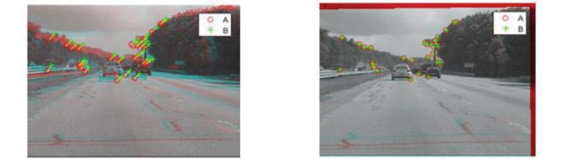
Step5 : Transform Approximation and Smoothing
-All the parameters i.e. the MSE’s are calculated and the least possible value of the MSE is found. The least possible value of MSE indicates the Least Displaces frame out of the three possible compensated images. And thus, the Approximation and Smoothing is done.
Fig5 : Correspondence Between points
Fig6 : Showing the differences in the two Frames

Slide 11
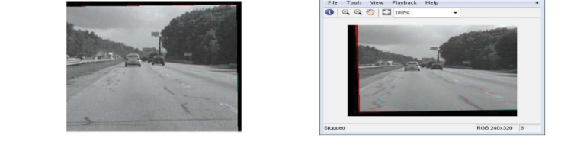
Step6: Run on the Full Video
-The above procedure of estimating the transform between multiple frames in a video has been performed in the MATLAB® function.
Step7: Corrected Frame Sequence:
-During computation, we computed the mean of the raw video frames and mean of the corrected frames and using the Mean Square Value is found and the best undistorted images are found and used in the video displaying proving that there was a great deal of distortion in the original video. The mean of the corrected frames on the left and right shows the image with almost no distortion.
Fig7 : Final Output with clear differences

Slide 12
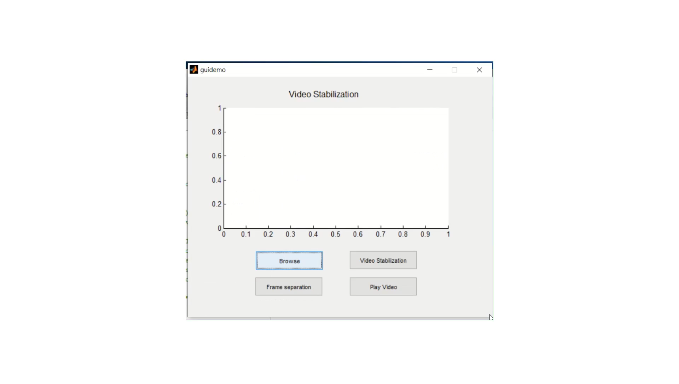
RESULT
INPUT VIDEO

Slide 13
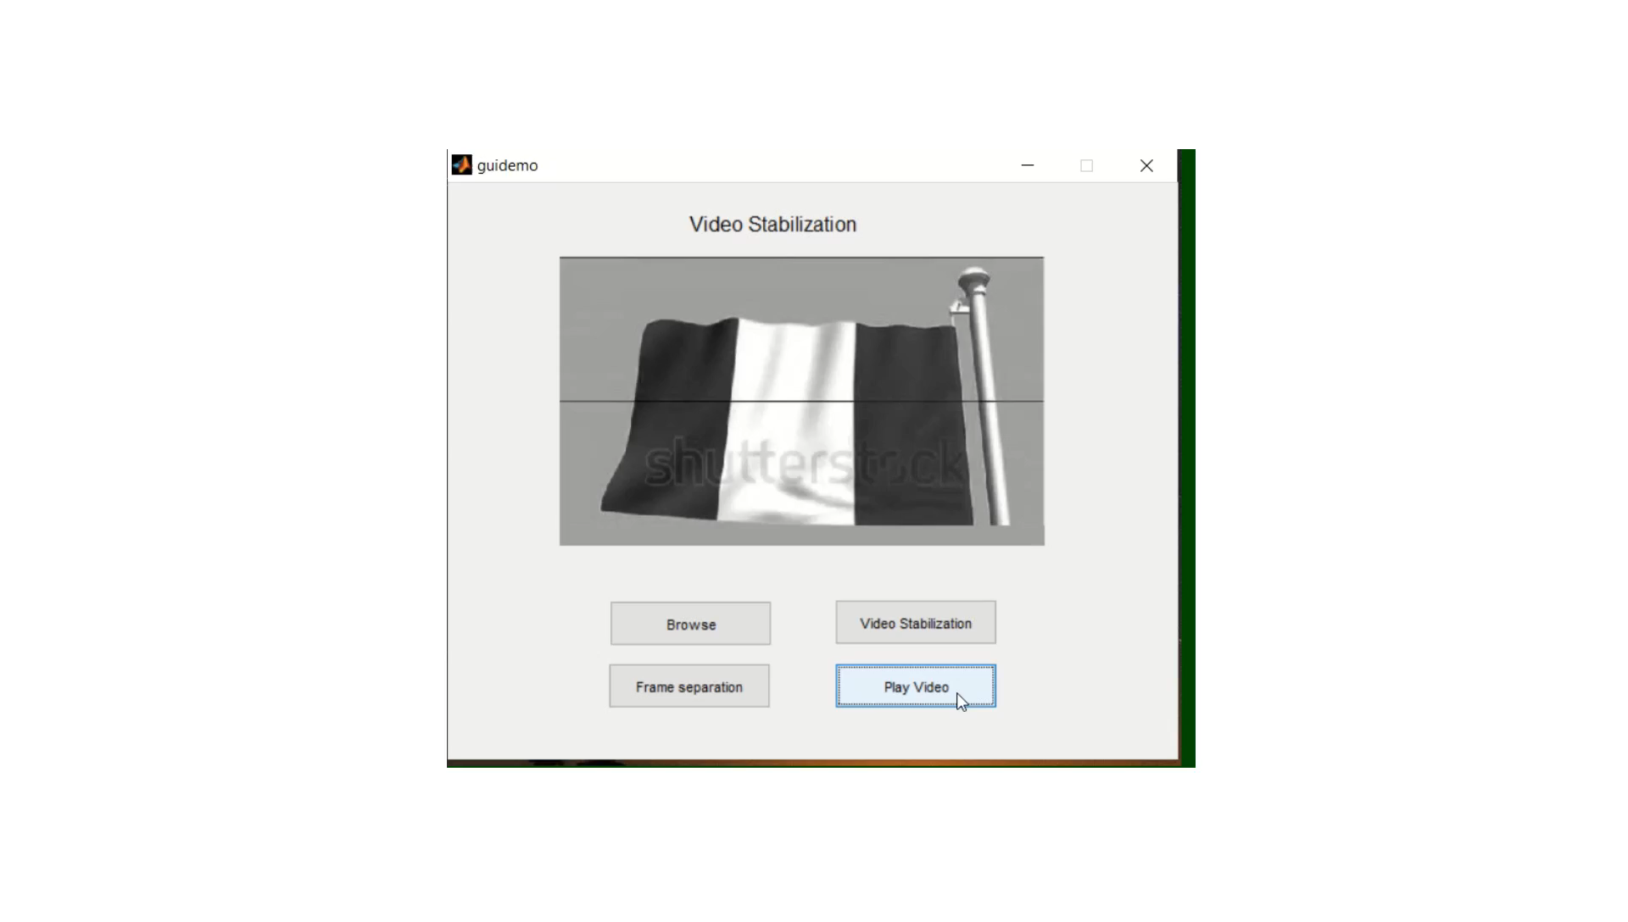
OUTPUT : STABILIZED VIDEO

Slide 14
APPLICATIONS
The need for video stabilization spans many domains.
It is extremely important in consumer and professional videography. Therefore, many different mechanical, optical, and algorithmic solutions exist. Even in still image photography, stabilization can help take handheld pictures with long exposure times.
In medical diagnostic applications like endoscopy and colonoscopy, videos need to be stabilized to determine the exact location and width of the problem.
Similarly, in military applications, videos captured by aerial vehicles on a reconnaissance flight need to be stabilized for localization, navigation, target tracking, etc. The same applies to robotic applications.

Slide 15
CONCLUSION AND FUTURE SCOPE
The video content has been stabilized. The degree of stabilization has been adjusted according to different demands. Able to handle stabilization of any unstabilized video as an input and having unlimited length videos.
FAST detection technique is particularly helpful in identifying people, license plates, etc. from low-quality video surveillance cameras.
In future, we can find better feature detector to overcome the consequences of extreme shaking of handheld camera in real time implementation for video stabilization.

Slide 16
REFERENCES
[1] Aleksandra Shnayderman, Alexander Gusev, and Ahmet M. Eskicioglu“An SVD-Based Grayscale Image Quality Measure for Local and GlobalAssessment “,IEEE 15(2), 2006.
[2]B.-Yu. Chen, K.-Yi. Lee, W.-T. Huang, J.-S. Lin, “Capturing Intention-based Full-Frame Video Stabilization,” Computer Graphics Forum, Vol. 27, No. 7, p.1805 - p.1814, 2008.
[3] C. Harris and M.J. Stephens, “A combined corner and edge detector”, Proc of Alvey Vision Conference, pp 147–152, 1988.

Slide 17
Thank You.

